Slide 1
Biodiversity for the National Parks
By Danielle Nissenbaum

Slide 2
Describing the Data in species_info.csv
Category – What is the category of the animal?
Scientific name - The scientific name of each species
Common names - The common names of each species
Conservation status - The species conservation status
I found out that there are 5,541 different species in the whole data, 7 different values of categories (Mammal, Bird, Reptile, Amphibian, Fish, Vascular Plant, Nonvascular Plant) and 5 different values of Conservation status (nan, Species of Concern, Endangered, Threatened, In Recovery)

Slide 3
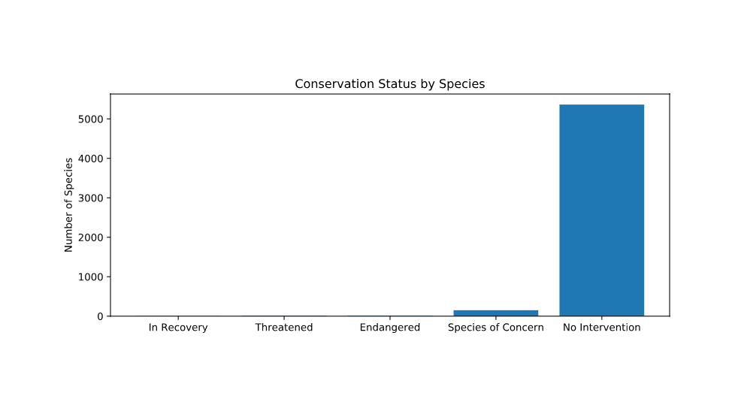
Analyze Species Conservation Status
First I counted with group by operator how many scientific names fall into each conservation status criteria
When I did the previous calculation I didn’t include the ‘NaN’ values since group by doesn’t include ‘NaN’. In order to fix that, I used .fillna function which fills in all of the ‘NaN’ values with a new argument – ‘No Intervention’ that I created.
When I finished the calculation I found out that there are 15 species that are Endangered, 4 species that are In Recovery, 151 Species of Concern, 10 species Threatened and 5,363 species that have no intervention
The significance calculations I did for endangered status between different categories of species are:
In order to see the results visually I plot a bar chart with all the data:

Slide 4
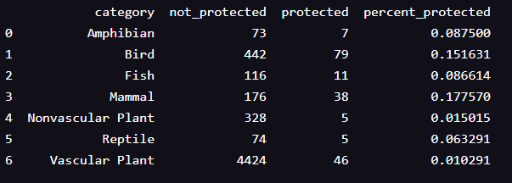
Investigating Endangered Species
I rearranged the species data frame and pivot in a new data frame called category pivot which includes the percent of the protected animals in each type of species:

Slide 5
Chi-Squared Test for Significance
I created a contingency table with the data from Mammal and Birds
I found out that the p-value is 0.687594 so I can say that the difference between the percentages of protected birds and mammals is not significant and is a result of chance.
As I did above I compared the percentages of protected Reptiles and Mammals with Chi-Square test and I found out that the p-value is 0.0383555, which says that there is significant difference between Reptails and Mammals.
In order to check if the differences between Mammal and Birds are significant or due to chance I used Chi-Squared test:

Slide 6
Recommendation
According to the significance calculations, my recommendations are to protect the types of species that are more likely to be endangered than others, and to keep track of the different protected and not protected species and see if there is a significant difference between them.

Slide 7
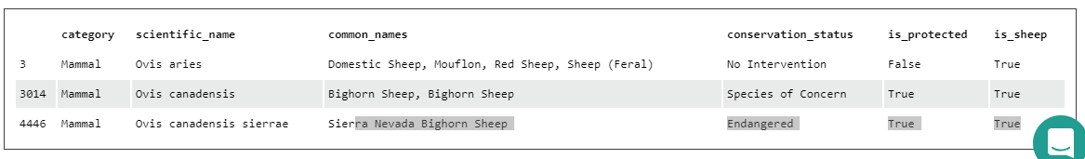
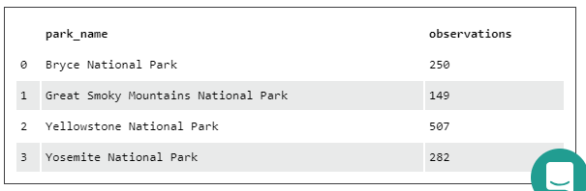
Foot and Mouth Reduction Effort
In Search of Sheep
In order to check if the program to reduce the rate of foot and mouth disease at Yellowstone National Park I did the following steps:
First I rearranged the species Data frame to include all the rows that their category is ‘Mammal’ and their common name includes ‘Sheep’.
Then, I merged this data frame with the observations data frame and grouped it by park name.

Slide 8
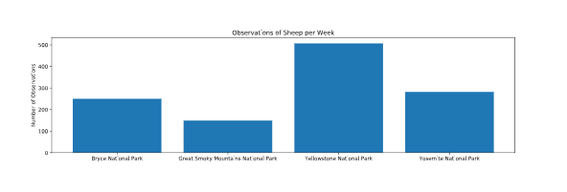
Foot and Mouth Reduction Effort
In Search of Sheep
Finally, I plotted a bar chart showing the different number of observations per week at each park-

Slide 9
Foot and Mouth Reduction Effort
Sample Size Determination
In order to determine the sample size we need 3 variables:
Baseline – 0.15
Minimum detectable effect – 33.3333333
Statistical significance – 90%
I plugged all the variables into the sample size calculator and I figured that the sample size should be – 870
After I got the sample size that I analyzed, I can see that it will take approximately 1 week to observe enough sheep at Yellowstone National Park and approximately 3 weeks to observe enough sheep at Bryce National Park.

Slide 10
Thank you!

